Slide 1
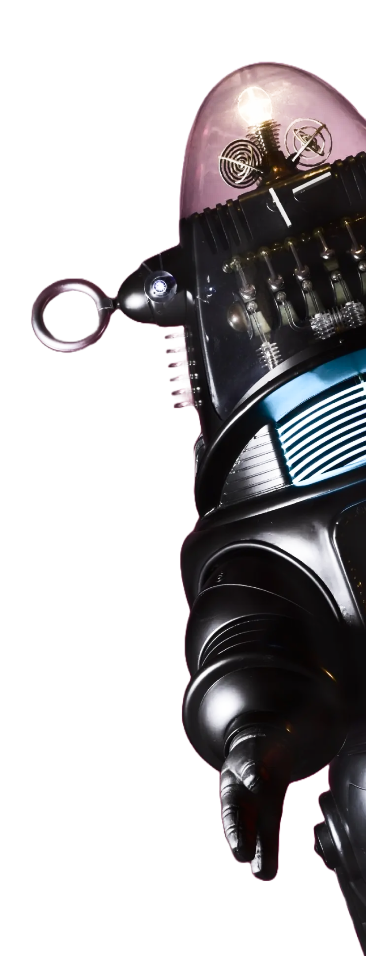

We’ll Resume at 4PM

Slide 2
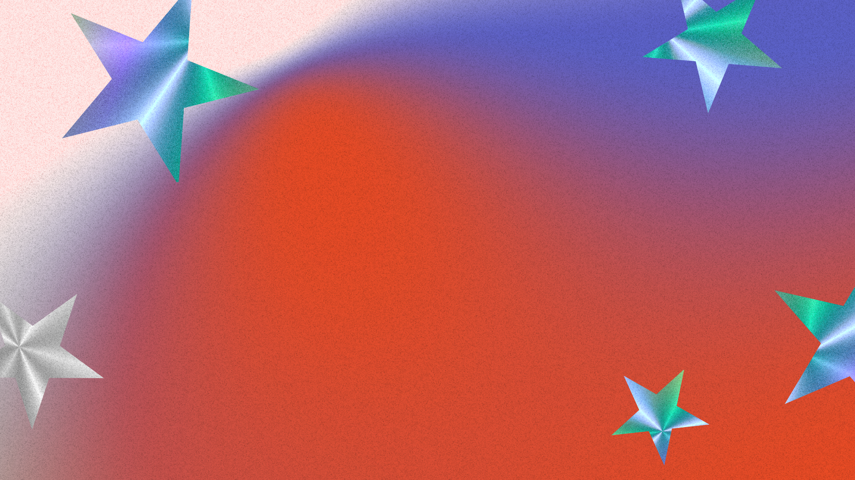
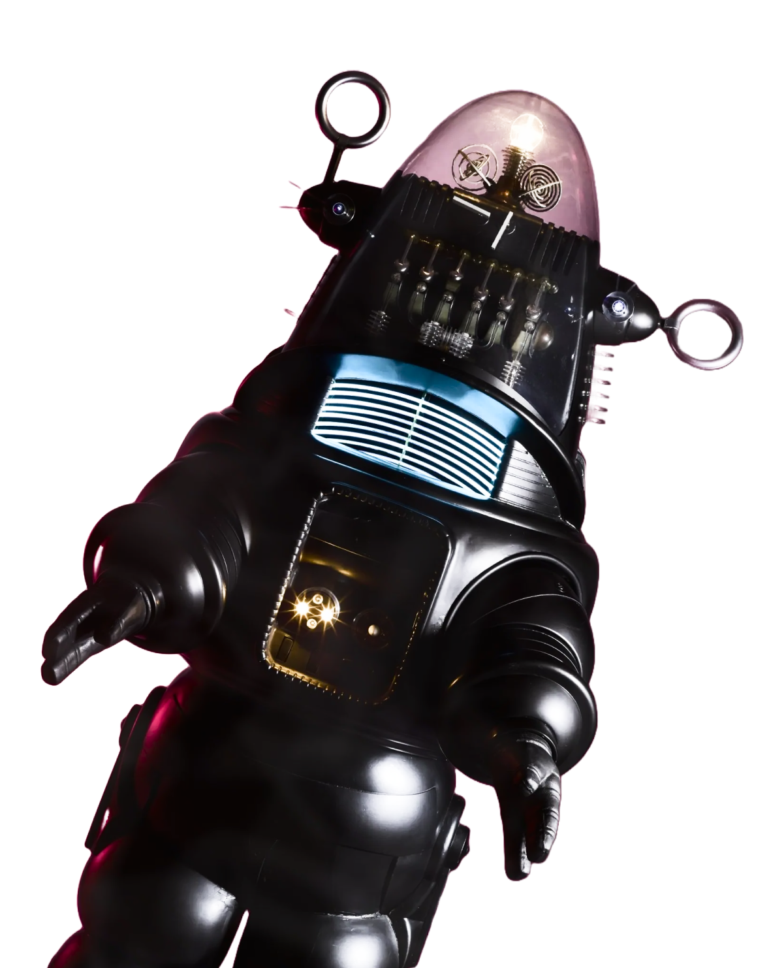
People’s
Choice

Slide 3


17
NSF.gov/SearchAwards
Our challenge was enhancing the AI readability of NSF.gov/AwardSearch to improve data transparency, support research and innovation, and enhance user experience in the process.
One problem was that common AI GPT tools would not parse the traditional filetype: .xml in real-time so users were being routed to the Advanced Search feature (https://www.nsf.gov/awardsearch/advancedSearch.jsp) for further queries. This was not as efficient for many modern users and provided options not relevant to all user personas.
Our solution was to create a ChatGPT custom GPT, leverage a Standard GPT endpoint, and test on multiple user personas to develop greater personalization. This custom GPT can be used as an API improving both AI readability and customer engagement through specific user queries and natural communication. Our API can also be integrated via marketplace for use in chatbots, etc on NSF.gov’s Awards Search site.

